Slide 1
OBJECT ORIENTED CONCEPTUAL MODELING Session 17&18
Course : ISYS6280 – Database Systems (GAT)
Year : 2017

Slide 2
LEARNING OUTCOME
LO 3: Design database using Object Oriented data model

Slide 3
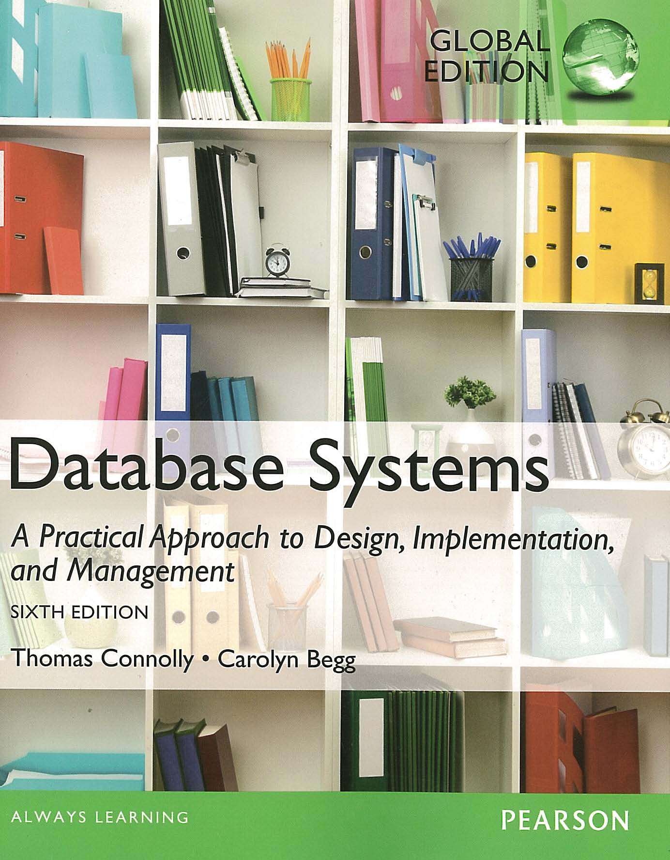
ACKNOWLEDGEMENT
These slides have been adapted from Thomas Connolly and Carolyn Begg. 2015. Database Systems: A Practical Approach To Design, Implementation, and Management. Pearson Education. USA. ISBN:978-1-292-06118-4

Slide 4
CHAPTER 28 OODBMS – STANDARDS AND SYSTEMS

Slide 5

Learning Objectives
Main features of Object Data Management Group Object Standard:
Object model
Object Definition Language (ODL)
Object Query Language (OQL)
vtraining-msuhandi.blogspot.com

Slide 6
Object Data Management Group
Established by vendors of OODBMSs to define standards.
Have produced an Object Model that specifies a standard model for the semantics of database objects.
Design of class libraries and applications using these semantics should be portable across various OODBMSs.

Slide 7
Object Data Management Group
Between release 2.0 (1997) and 3.0 (late 1999), ODMG expanded its charter to cover the specification of universal object storage standards.
At same time, ODMG changed its name from Object Database Management Group to Object Data Management Group to reflect expansion of its efforts beyond merely setting storage standards for object databases.
The Java binding was submitted to JCP as basis for Java Data Objects (JDO).
In 2001, ODMG completed its work and disbanded.

Slide 8
Object Data Management Group
Under its extended charter, ODMG specification covers both OODBMSs that store objects directly and Object-to-Database Mappings (ODMs) that convert and store the objects in a relational or other database system representation.
Both types of products are referred to generically as Object Data Management Systems (ODMSs).
ODMSs make database objects appear as programming language objects in one or more existing OOPLs, and extend programming language with transparently persistent data, concurrency control, recovery, associative queries, and other database capabilities.

Slide 9
Object Data Management Group
Major components of ODMG architecture for an OODBMS :
Object Model (OM).
Object Definition Language (ODL).
Object Query Language (OQL).
C++, Smalltalk, and Java Language Binding.

Slide 10
The Object Model - Basic Modeling Primitives
Basic modeling primitives are object/literal. Only an object has a unique identifier.
Objects/literals can be categorized into types. All objects of given type exhibit common behavior and state. A type is itself an object.
Behavior defined by set of operations that can be performed on or by object.
State defined by values objects carry for a set of properties. Property may be either an attribute of object or relationship between object and one or more other objects.
Object Data Management Systems (ODMS) stores objects, enabling them to be shared by multiple users and applications. ODMS based on a schema defined in ODL.

Slide 11
The Object Model - Objects
An Object is described by four characteristics :
Structure
Identifier
Name
Lifetime

Slide 12
Objects - Structure
Object types decomposed as atomic, collections, or structured types.
Structured types as defined in ISO SQL standard.
Objects created using new() of corresponding factory interface provided by language binding.
Object Factory Interface has new method to create a new instance of type object.
In addition, all objects have the ODL interface, which is implicitly inherited by the definitions of all user-defined object types

Slide 13
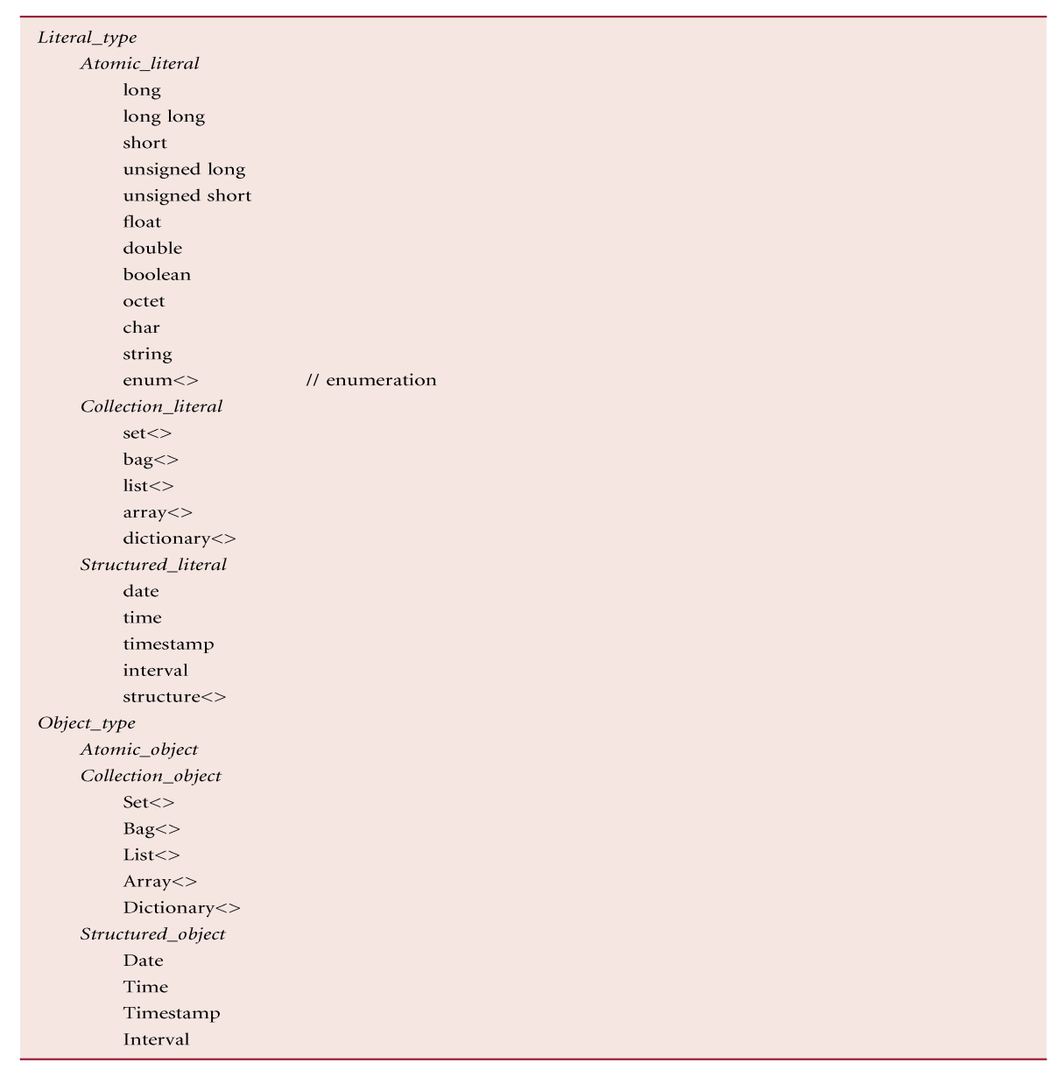
Set of Built-in Types for ODMG Object Model

Slide 14
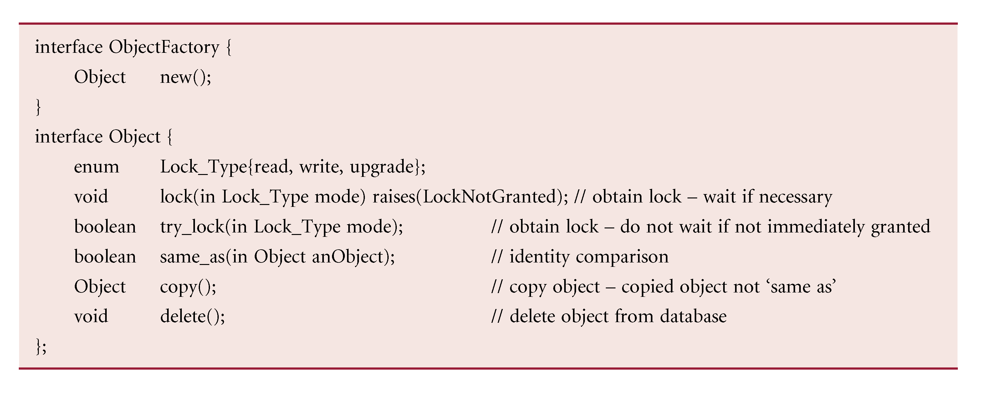
ODL Interface for Objects

Slide 15
Objects – Identifier and Names
Each object has a unique identity, the object identifier, which does not change and is not reused when the object is deleted.
An Object may also be given one or more names that are meaningful to the user.
Object names act as “root” objects that provide entry points into the database.

Slide 16

Objects – Lifetimes
Lifetime specified when object is created:
Transient: object’s memory allocated and deallocated by programming language’s runtime system.
Persistent: object’s storage managed by OODBMS.
instridesports.com

Slide 17
Object Model - Literals
A constant, with possibly complex structure.
Literal types decomposed as atomic, collections, structured, or null.
Values of a literal’s properties may not change.
Do not have their own identifiers and cannot stand alone as objects. Embedded in objects and cannot be individually referenced.
Structured literals contain fixed number of named heterogeneous elements. Example :
struct Address {
string street;
string city;
string postcode;
} ;
attribute Address branchAddress;

Slide 18
Object Model - Built-in Collections
Contains arbitrary number of unnamed homogeneous elements; each can be instance of atomic type, another collection, or a literal type.
Only collection objects have identity.
Use iterator to iterate over collection.
Ordered and unordered collections:
ordered: traversed first to last, or vice versa;
unordered: no fixed order of iteration.
Five built-in collection subtypes :
Set: unordered collections without duplicates.
Bag: unordered collections that do allow duplicates.
List: ordered collections that allow duplicates.
Array: 1D array of dynamically varying length.
Dictionary: unordered sequence of key-value pairs with no duplicate keys.

Slide 19
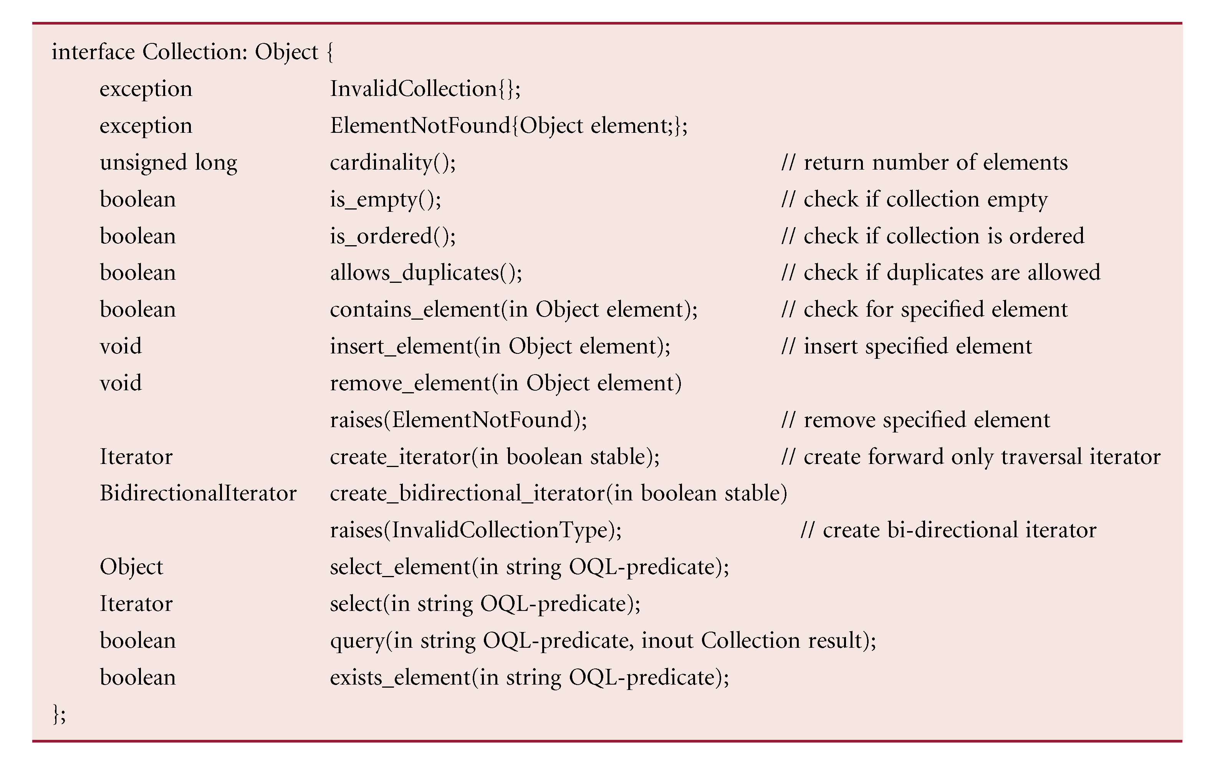
ODL Interface for Collections

Slide 20
Object Model – Atomic Objects
Any user-defined object that is not a collection object is called an atomic object.
Atomic objects are represented as a class, which comprises state and behavior.
State represented by set of properties (attribute or relationship).
Attribute is not a “first class” object (i.e. not an object and so no Object Identifier). Ex. A Branch Class has attributes for the branch number, street, city, and postcode

Slide 21
Object Model - Relationships
Only binary relationships supported.
Traversal paths are defined for each direction of traversal.
class Branch {
relationship set <Staff>Has inverse Staff::WorksAt}
class Staff {
relationship Branch WorksAt inverse Branch::Has}

Slide 22
ODMG Object Model - Types, Classes, Interfaces, and Inheritance
Two ways to specify types: interfaces and classes.
Interface is a specification that defines only abstract behavior of an object type, using operation signatures.
Behavior inheritance allows interfaces to be inherited by other interfaces/classes (but properties cannot be inherited from the interface).
Interface also non instantiable – cannot create objects from an interface
Normally, interfaces used to specify abstract operations that can be inherited by classes or by other interfaces.

Slide 23
ODMG Object Model - Types, Classes, Interfaces, and Inheritance
Class defines both the abstract state and behavior of an object type, and is instantiable.
Thus, interface is an abstract concept and class an implementation concept.
Can specify single inheritance between classes using extends keyword.
Multiple inheritance not allowed using extends but is allowed using behavior inheritance.
Class definition can specify its extent and keys :
Extent : set of all instances of given type. May request ODMS maintain index to members of this set.
Key : uniquely identifies the instances of a type (similar to the concept of a candidate key).

Slide 24
ODMG Object Model
Object model also specifies:
Exceptions
Metadata
Transactions
Databases
Modules

Slide 25
Object Definition Language (ODL)
ODL is a language for defining the specifications of object types for ODMG-compliant systems, equivalent to the DDL of traditional DBMSs
module DreamHome
Class Branch
(extent branchOffices key branchNo)
{
attribute string branchNo;
….
relationship Manager ManagedBy inverse Manager::Manages;
void takeOnPropertyForRent(in string propertyNo)
raises(propertyAlreadyForRent);
}

Slide 26
Object Definition Language (ODL)
class Person {
attribute struct Pname {string fName, string lName} name;
}
Class Staff extends Person
(extent staff key staffNo)
{
attribute staffNo;
attribute date DOB;
….
short getAge();
}

Slide 27
Object Definition Language (ODL)
class Manager extends Staff
(extent managers)
{
relationship Branch Manages
inverse Branch::ManagedBy;
}

Slide 28
Object Query Language (OQL)
Provides declarative access to object database using SQL-like syntax.
Does not provide explicit update operators - leaves this to operations defined on object types.
Can be used as a standalone language and as a language embedded in another language, for which an ODMG binding is defined (Smalltalk, C++, and Java).
OQL can also invoke operations programmed in these languages.

Slide 29
Object Query Language (OQL)
Can be used for associative and navigational access:
Associative query returns collection of objects. How these objects are located is responsibility of ODMS.
Navigational query accesses individual objects and object relationships used to navigate from one object to another. Responsibility of application program to specify procedure for accessing the objects.

Slide 30
Object Query Language (OQL)
An OQL query is a function that delivers an object whose type may be inferred from operator contributing to query expression.
Query definition expressions is of form:
DEFINE Q as e
Defines query with name Q given query expression e.

Slide 31
Object Query Language (OQL)
Expression can take several forms:
Elementary - Construction
Atomic type - Object
Collection - Indexed collections
Binary set - Conversion
Query consists of a (possibly empty) set of query definition expressions followed by an expression.
Result is object with or without identity.
Pearson Education © 2014
31

Slide 32
Example 28.2 OQL: Extents & Traversal Paths
(1) Get set of all staff (with identity)
staff
(2) Get set of all branch managers (with identity)
branchOffices.ManagedBy
(3) Find all branches in London
SELECT b.branchNo
FROM b IN branchOffices
WHERE b.address.city = “London”;
This returns a literal of type bag<string>.

Slide 33
Example 28.2 OQL: Extents & Traversal Paths
Assume londonBranches is named object (from last query). Find all staff who work at that branch.
londonBranches.Has
This returns set<SalesStaff>.
Because of ambiguity over return result, cannot access sales staff salaries using:
londonBranches.Has.salary
Result may be set<float> or bag<float>.
Instead use:
SELECT [DISTINCT] s.salary
FROM s IN londonBranches.Has;

Slide 34
Example 28.3 - OQL: Use of DEFINE
Get set of all staff who work in London (without identity).
DEFINE Londoners AS
SELECT s
FROM s IN salesStaff
WHERE s.WorksAt.address.city = “London”;
SELECT s.name.lName FROM s IN Londoners;
This returns a literal of type set<string>.

Slide 35
Example 28.3 - OQL: Use of DEFINE
Can generalize this:
DEFINE CityWorker(cityname) AS
SELECT s
FROM s IN salesStaff
WHERE s.WorksAt.address.city = cityname;
CityWorker(“London”);
CityWorker(“Glasgow”);

Slide 36
Example 28.4 OQL: Use of structures
Get structured set (without identity) containing name, sex, and age of all staff who live in London.
SELECT struct (lName:s.name.lName, sex:s.sex,
age:s.age)
FROM s IN Staff
WHERE s.WorksAt.address.city = “London”
This returns a literal of type set<struct>.

Slide 37
Example 28.4 OQL: Use of structures
Get structured set (with identity) with name, sex, and age of all deputy managers over 60:
class Deputy {attribute string lName; attribute sexType sex; attribute integer age;};
Typedef bag<Deputy>Deputies;
Deputies (SELECT Deputy (lName:s.name.lName,
sex:s.sex, age:x.age)
FROM s IN salesStaff
WHERE position = “Deputy” AND s.getAge > 60)
This returns a mutable object of type deputies.

Slide 38
Example 28.4 OQL: Use of structures
Get structured set (without identity) containing branch number and set of all Assistants at branches in London.
SELECT struct (branchNo:x.branchNo, assistants:
(SELECT y FROM y IN x.WorksAt
WHERE y.position = “Assistant”))
FROM x IN (SELECT b FROM b IN branchOffices
WHERE b.address.city = “London”)
This returns a literal of type set<struct>.

Slide 39
Example 28.5 OQL: Use of aggregates
How many staff work in Glasgow.
COUNT (s IN CityWorker(“Glasgow”);
OQL aggregate can be applied within SELECT or to result of SELECT.
Following equivalent:
SELECT COUNT(s) FROM s IN salesStaff
WHERE s.WorksAt.branchNo = “B003”;
COUNT(SELECT s FROM s IN salesStaff
WHERE s.WorksAt.branchNo = “B003”);

Slide 40
Example 28.6 OQL: GROUP BY
Determine number of sales staff at each branch.
SELECT struct(branchNumber,
numberOfStaff:COUNT(partition))
FROM s IN salesStaff
GROUP BY branchNumber: s.WorksAt.branchNo;
Result is of type: set<struct(branchNumber: string,
partition: bag<struct(s:SalesStaff)>)>
Note use of keyword partition to refer to each partition.

Slide 41
OQL - Creating Objects
A type name constructor is used to create an object with identity.
Manager(staffNo: “SL21”,
fName: “John”, lName: “White”,
address: “19 Taylor St, London”,
position: “Manager”, sex: “M”,
DOB: date“1945-10-01”, salary: 30000)

Slide 42
Mapping Conceptual Design to Logical OO Design
Step 1 Mapping classes
Map each class or subclass to an ODL class, including all appropriate attributes and methods.
Map composite attributes to a tuple constructor using a struct declaration.
Map any multivalued attributes as follows:
if values are ordered, map to a list constructor;
if values contain duplicates, map to a bag constructor;
otherwise, map to a set constructor.
Create an extent for each class that will be iterated over. Specify EXTENDS for each ODL class that represents a subclass to inherit attributes and methods of superclass.

Slide 43
Mapping Conceptual Design to Logical OO Design
Step 2 Mapping binary relationships
Add a relationship property (or reference attribute) into each class that participates in relationship.
If supported, use inverse relationships where possible to ensure system automatically maintains RI; otherwise program this functionality into class methods.
If 1:1, each relationship property will be single-valued.
If 1:*, relationship property will be single-valued on one side and collection type (list or set) on the other.
If *:*, each side will be a collection type.
Create tuple constructor (struct) for relationships attributes of form <relationship reference, relationship attributes>.

Slide 44
Mapping Conceptual Design to Logical OO Design
Step 3 Mapping n-ary relationships
For each relationship with degree greater than 2, create separate class to represent relationship and include relationship property (based on a 1:* relationship) to each participating class.
Step 4 Mapping categories
For each category (union type), create class to represent category and define a 1:1 relationship between category class and each of its superclasses.
Alternatively, a union type can be used if OODBMS supports it.

Slide 45

www.healthytravelblog.com

